Slide 1
Hydro Water Spinner
A modern and innovative creation by Energized Speedrunners

Slide 2
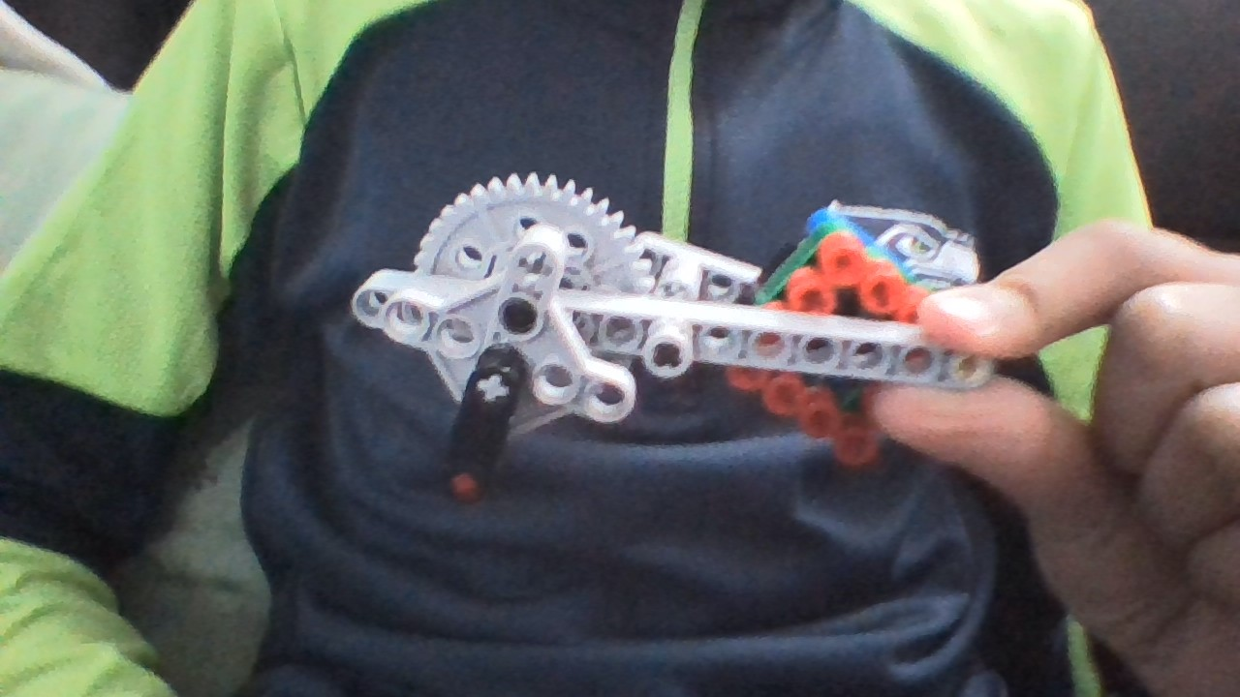



What it is
As the name suggests, it is a tool utilizing hydraulics and turning it into a modern new tool that will turn water coming at moderate pressures (like a sink…).
A star blade sits on a axel that connects to a gear ratio. This ratio maximizes the rotation coming from the axel to another axel that is rotating faster because of the faster gear ratio. That faster axel, will be connected to a generator.
This is an example of what it could look like. Note: This is made out of lego.

